Slide 1
DEG & NLP
Thomas L. Packer

Slide 2
Overview
Lab Overlap
My Interests
Knowledge Engineering
Statistical Natural Language Processing
(Cognitive Science)

Slide 3
What do these have in common?
Computer Vision: Interpreting scene of man eating.
Expert Systems and Question Answering: “I’ve been acting like an athlete and now my foot hurts. Do I have athlete’s foot?”
NLP: Interpreting “bank” in context of finance or geology.
Using world knowledge to infer new knowledge.

Slide 4
What is NLP?
“NLP… studies the problems of automated generation and understanding of natural human languages. … Natural language understanding systems convert samples of human language into more formal representations that are easier for computer programs to manipulate.”
“NLP … deals with analyzing, understanding and generating the languages that humans use naturally in order to interface with computers. … One of the challenges inherent in natural language processing is teaching computers to understand the way humans learn and use language. Take, for example, the sentence “Baby swallows fly.” …

Slide 5
Which should come first, the chicken or the egg?
NLP appeared on the last two slides:
Needs knowledge to operate.
Should produce knowledge as it operates.
Need a grammar to acquire world knowledge.
Need world knowledge to acquire a grammar.

Slide 6
What is DEG?
Data Extraction Group
Information Extraction from Web Pages
Data Engineering Group
Knowledge Engineering for the Semantic Web
Professors:
Dr. David W. Embley (CS)
Dr. Deryle W. Lonsdale (Linguistics)
Dr. Stephen W. Liddle (Business School)

Slide 7
DEG Research
Ontology-Based Information Extraction
Ontologies help identify information, especially in structured settings
Extraction fills ontologies
Semantic Web (Web 3.0) W3C Standards and Goals
OWL: “Web Ontology Language” (Schema)
RDF: “Resource Description Framework” (Data “triples”)
Annotate the Web with respect to machine-readable ontologies

Slide 8
What is an Ontology?
Shared knowledge about a domain
Based on Description Logic
Unlike Databases:
No closed-world assumption: Infer new facts instead of assuming false.
No unique name assumption: same individual, different names
Temporary inconsistency allowed, unlike database that prevent assertions that violate constraints
Schema is a set of axiom: behaves like inference rules.

Slide 9
The Semantic Web Vision
Make the vast and growing knowledge on the Web machine-usable:
Information retrieval
Information integration
Question answering
Intelligent agents/services

Slide 10
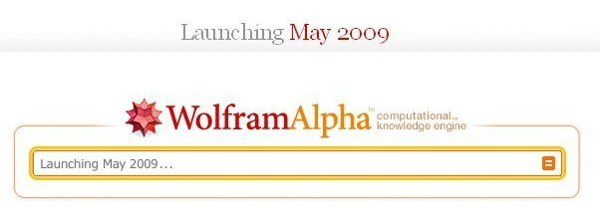
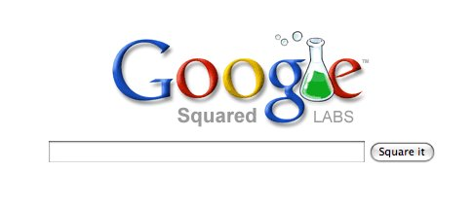
Existing Applications: Semantic Search and Question Answering

Slide 11
Yesterday’s News
Wolfram-Alpha Demo:
http://news.cnet.com/wolfram-alpha-shows-data-in-a-way-google-cant/
Superficial News on Both:
http://www.necn.com/Boston/SciTech/2009/05/14/Wolfram-Alpha-search-engine/1242305499.html

Slide 12
How to Achieve the Semantic Web Vision
Lots of Data (Knowledge)
Lots of Linguistic Knowledge
Hard to create by hand
Must automate the acquisition of knowledge

Slide 13
Approaches to Knowledge Acquisition
Manual
Transcribing, expert coders
Hand-written rules
Web page wrappers, extraction rules
Knowledge-based
Find structures with knowledge overlap
Supervised Machine learning
HMMs, CRFs
Hybrid Semi-Supervised Approaches
… where cool things are starting to happen.

Slide 14
My Interests
Information Extraction and Integration
Bootstrapped Knowledge and Language Acquisition.
World Knowledge
Linguistic Knowledge
Grammar Induction

Slide 15
Challenge
Semantic drift: Feedback loop amplifies error and ambiguities.
Semi-Supervised learning often suffers from being under-constrained.

Slide 16
Solution
Self-Supervised Learning:
“Instead of utilizing hand-tagged training data, the systems select and label their own training examples, and iteratively bootstrap their learning process. Self-supervised systems are a species of unsupervised systems because they require no hand-tagged training examples whatsoever. However, unlike classical unsupervised systems (e.g., clustering) self-supervised systems do utilize labeled examples and do form classifiers whose accuracy can be measured using standard metrics. Instead of relying on hand-tagged data, self-supervised systems autonomously “roll their own” labeled examples.” — Oren Etzioni, “Machine Reading”, 2007.

Slide 17
How can you Self-Supervise?
My thought process
Cognitive Science Background: Making and Testing Predictions
http://www.ted.com/index.php/talks/jeff_hawkins_on_how_brain_science_will_change_computing.html
(10:00 – 11:45)
Alternative: Passively wait for contradictions or independent supporting evidence.

Slide 18
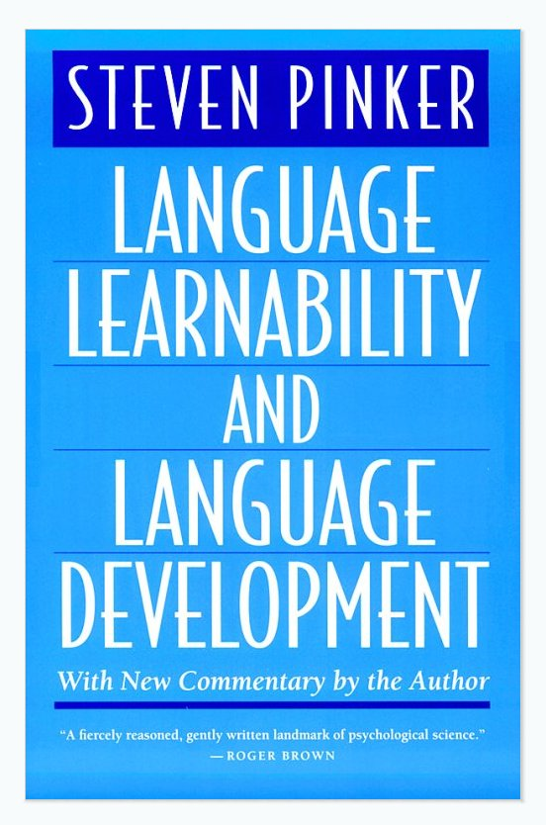
Bootstrapping Cognitive Science Background
Steven Pinker (1984) describes theoretical processes that human children may use — not for parsing a sentence in a given language, but for learning a system capable of parsing sentences in any human language.
“Semantic bootstrapping” and “structure-dependent distributional learning of syntax and semantics”
Pseudo-code level detail.

Slide 19
Current Research Proposals
Tom Mitchell proposes Never-Ending Language Learning: “Significant progress has been made recently in semi-supervised learning algorithms … [especially] in the context of natural language analysis. This talk will [among other things] explore the possibility that now is the right time to mount a community-wide effort to develop a never-ending natural language learning system.” — Tom Mitchell, “Learning, Information Extraction and the Web”, 2007.
Oren Etzioni proposes Machine Reading: “The time is ripe for the AI community to set its sights on ‘Machine Reading’—the autonomous understanding of text. … In contrast with many NLP tasks, MR is inherently unsupervised.” (Or rather, self-supervised.) — Oren Etzioni, “Machine Reading”, 2007.

Slide 20
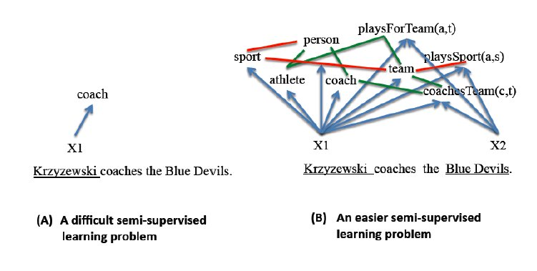
Tom Mitchell’s Coupled Semi-Supervised Extraction

Slide 21
Tom Mitchell’s Coupled Semi-Supervised Extraction
Simultaneous bootstrapped training of multiple categories and multiple relations.
Growing related knowledge provides constraints to guide continued learning.
Ontology Constraints:
Mutually exclusive predicates give each other negative instances and patterns.
Hyponyms give positive instances to their hypernyms.
Predicate argument type constraints give positive category instances and negative relation instances.

Slide 22
Oren Etzioni’s KnowItAll System
Cool stuff involving self-supervised learning.

Slide 23
My (Hopeful) Contribution
Multiple semi-independent but mutually reinforcing sources of evidence.
Propagation of evidence through the feedback loop (bootstrapping) between knowledge acquisition and language acquisition.
Self-supervised learning based on amplification of newly-acquired knowledge through inference, used to propose and test candidate knowledge.

Slide 24
The Value of Inter-Lab Involvement
NLP provides linguistic and statistical knowledge.
DEG provides world knowledge knowledge (meta-knowledge).
“Ringger Rigor”

Slide 25
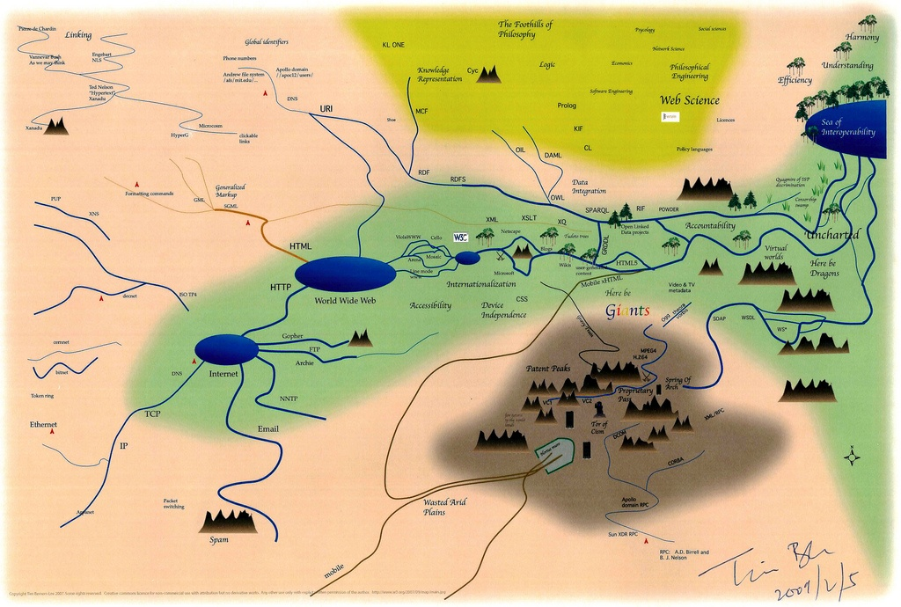
Questions

